Slide 1
How to handle sugical instruments

Slide 2
Concept of Instrument Handling
It contributes to:
Minimizing tissue trauma
Enhancing precision
Maintaining a sterile environment

Slide 3
Categories
Cutting Instruments: Scalpels and scissors
Grasping and Holding Instruments: Forceps, needle holders, and clamps.
Retracting Instruments: Retractors, such as the Deaver or Balfour retractor
Hemostasis Instruments: Hemostats, ligature , clips, and suction devices

Slide 4
Correct Gripping Techniques
Scalpel: Use a pencil grip. This ensures maximal control during incisions and minimizes the risk of cutting deeper than intended.
Needle Holders: Tripod grip or thumb-ring grip for fine suturing tasks.
Forceps: Thumb and finger grip with gentle pressure. This grip is essential for handling delicate tissue, such as skin or mucous membranes.
Surgical Scissors: Hold with a ring and thumb grip; never use too much force to avoid excessive tissue cutting.
Hemostats and Clamps: Hold the instrument with a controlled grip, avoiding unnecessary pressure.

Slide 5
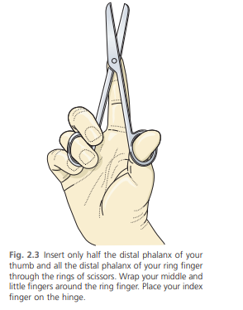
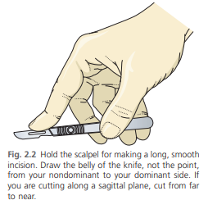

Slide 6
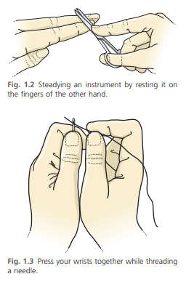
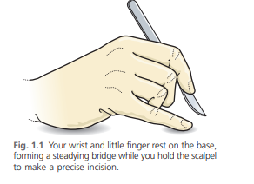

Slide 7
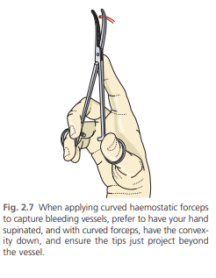

Slide 8
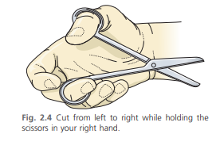
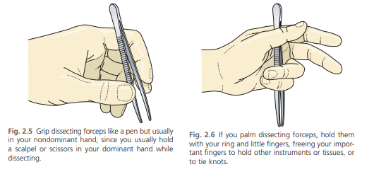

Slide 9
Common Mistakes in Instrument Handling
Incorrect Grips: Holding instruments too tightly or incorrectly may result in inadvertent tissue damage or loss of control.
Poor Ergonomics: The prolonged use of awkward grips can lead to hand strain, reducing efficiency and increasing the risk of injury.
Contaminating Instruments: Passing instruments improperly or touching the non-sterile areas of instruments may lead to contamination. Myint stresses that surgical teams must establish clear, consistent communication to pass instruments safely.
Excessive Force: Over-gripping or over-squeezing can damage tissues, especially in procedures where fine tissue manipulation is necessary (e.g., neurosurgery, vascular surgery).

Slide 10
Best Practices in Instrument Handling
Myint’s Technique for Passing Instruments:
Always pass instruments by placing the handle in the surgeon's palm. This avoids contamination of the sterile field and ensures secure transfer.
Use minimal hand movement: Avoid excessive sweeping motions or reaching beyond the sterile field.
Hand-off with care: Ensure that the recipient holds the instrument with a steady grip, ensuring no sudden movements that could cause injury.
Double-check before use: Inspect the instrument before use to ensure it’s in good working condition, especially scissors or clamps.

Slide 11
References
Polanyi M. Personal knowledge to RM Kirk London: Routledge & Kegan Paul, 1973,
Cross KD. Role of practice in perpetual-motor learning. Am Phys Med 1967;46-487 510
konding KP. Wolpert DM. Rayesian integration in sensorimotor learning. Nature 2004,427(6971):244-7.
Rubles de La-turne G. Principles of haptic perception in virtual environments. In Grumald M. editor. Human haptic perception Basel (Switzerland): Birkhäuser Verlag 2008. p. 363-79.

Slide 12
Thank you

